Slide 1
Why Open Source Instrumentation?
Interoperability
eg OpenTracing: https://opentracing.io/registry/
Portabilitate
Support for several analysis tool
Export to different backends
Ecosystem
Open source community
vizibilitate implicită
quick bootstrap
Notes:
interoperabilitate
poate ca ai 2 servicii sau 2000, dar daca telemetri data da la un serviciu nu e compatibil cu tel data de la altul o sa fie greu sa iti dai seama de performanta across them
poti sa iti faci propriul sistem , iti definesti un corelation identifier dar vin o gramada de intrevbari cum ar fi ce o sa folosesio UUID sau CUID ( collision resistant unique udentiier)
ajuta si pentru ca daca extinzi la un frontend , ai acelasi fel
sunt construite multe plugins pentri tot felul - de la queus la databases
Portabilitate
vrei practic ca datele pe care la strange sa fie folosite in diferite tooluri de analiza
nu vrei sa schimbi tracing code daca schimb analysis tool
eg - opentelemetry ca exemplu, seriviciu emite datala al un colector ( agent) care a capabil sa exporte catre diferite backends, poti trimite catre mai multe backends in acelasi timp( doar dintr-o configurare)
Ecosystem
visibilitate implicita- ai deja built in libraries pentru chestii gen framworkuri RPC, usor de adaugat
sau daca ai un service mesh, de multe ori e user sa dauci traces ca sa observi comunicarea , fara extra code
combini cu client level tracing , db client tracind and so on

Slide 2
Why OpenTelemetry?
We do not want to reinvent the wheel
portability
Ideal for cloud native

Slide 3
Open Telemetry - Components
API
SDK
Collector
Notes:
sunt interoperable and composable with each other .
poti sa le ilocuieti atata timp cat noua implementarea e conforma cu specificationul si data modelul

Slide 4
Application overhead
Latency
Throughput
Notes:
latency
gathering date pentru tracing adauga timp la latency
create a span - new object is created , reading the value from a timer + maybe updating some value on a thread local state
logging an event - serializing the data
finish a span , reading a value from a timer , update a field in an object
solutii - move the tracing o a background thread ( responsabil de serializare , sau buffering ca sa reduci si network overhead
throughput
the number of request that the infrastructure can handle in a fixed period of time
increased infrastructure costs pentur ca e nevoie de more computing power to handle same amount of requests
daca ai buffering , reduci network overhead dar increase the memory
timpul de buffering ar trebui sa fie < 1 minute, ca sa ai cat de cat real time thing
poti face si compress la span data , again trade intre compute si network in acest caz

Slide 5
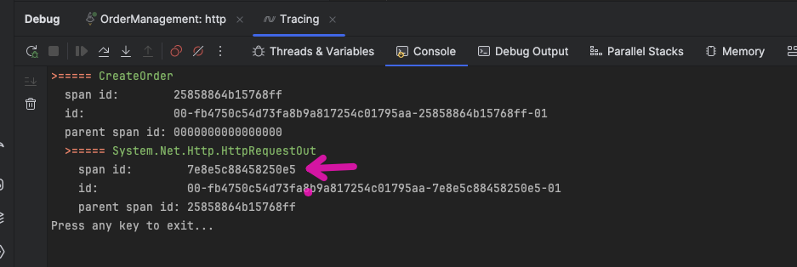
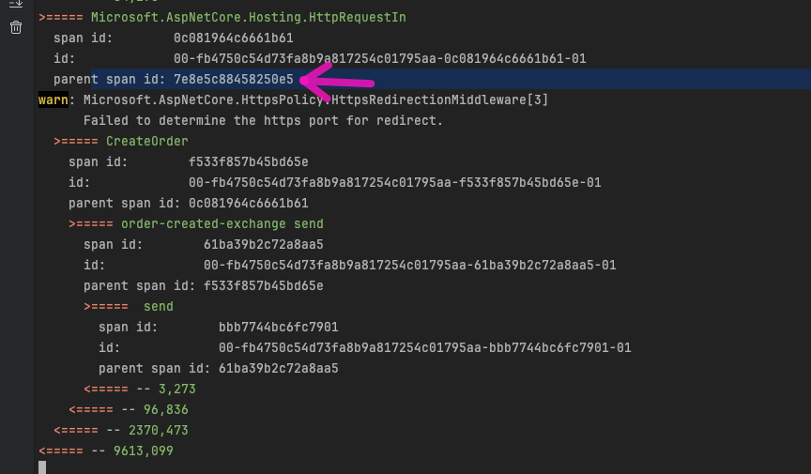
Ce primesti ‘gratis’?
se poate folosi standardul OpenTelemetry
multe din pachetele folosite sunt deja instrumentate

Slide 6

Jaeger
free
opensource
lightweight
Notes:
opentelemetry does not export everything by default, you have to tell which ones you want
https://github.com/open-telemetry/opentelemetry-dotnet/blob/main/docs/trace/getting-started-jaeger/README.md

Slide 7
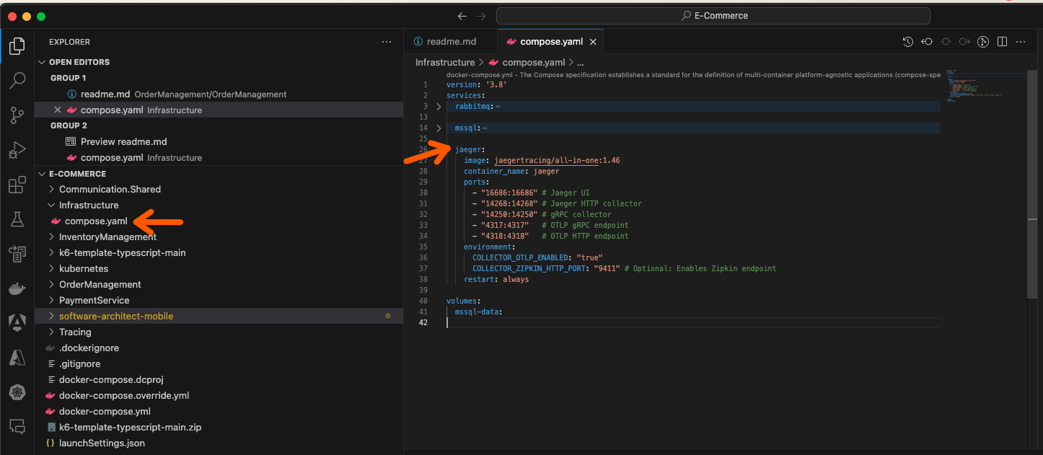
Setup Jaeger
Notes:
opentelemetry does not export everything by default, you have to tell which ones you want
https://github.com/open-telemetry/opentelemetry-dotnet/blob/main/docs/trace/getting-started-jaeger/README.md

Slide 8
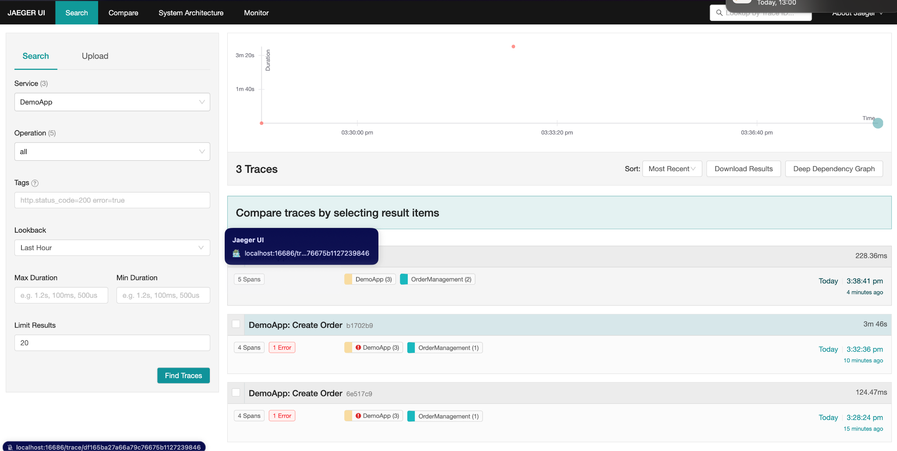
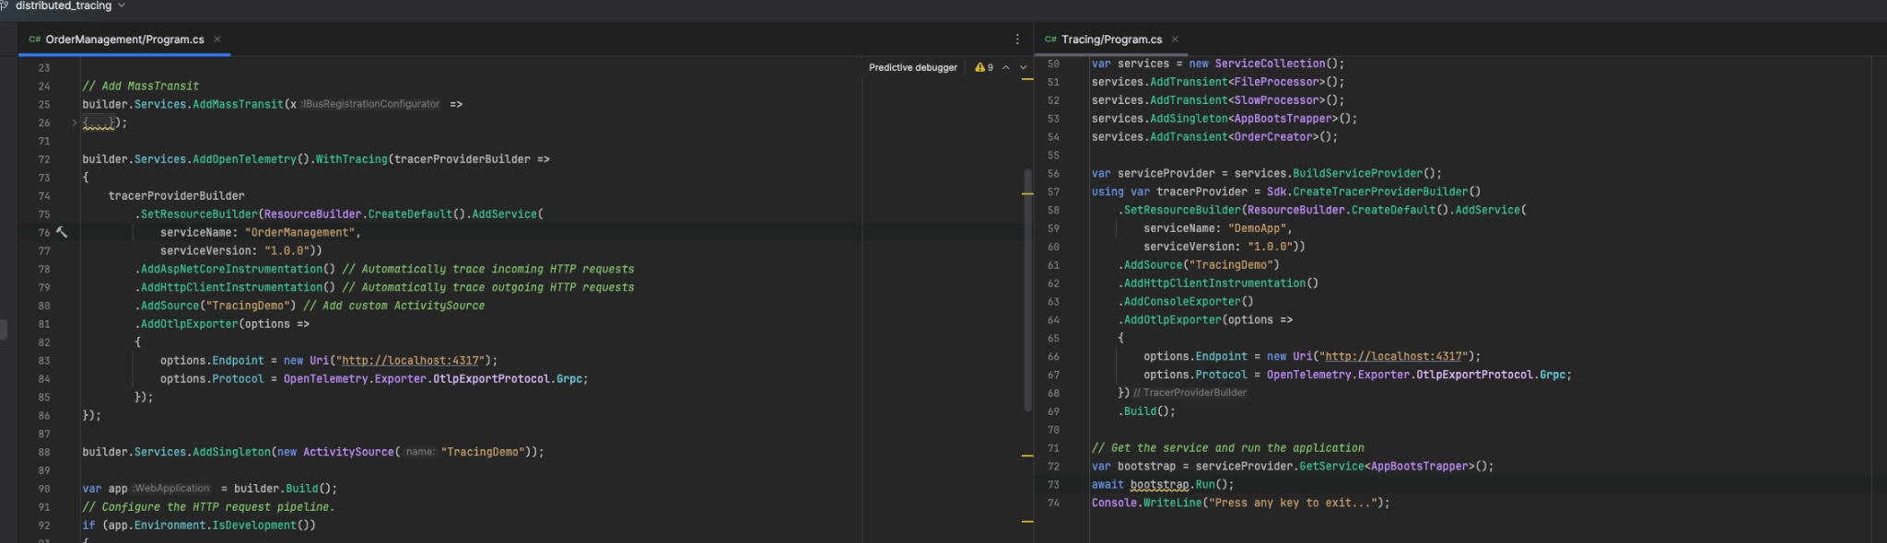
Jaeger
Notes:
opentelemetry does not export everything by default, you have to tell which ones you want
https://github.com/open-telemetry/opentelemetry-dotnet/blob/main/docs/trace/getting-started-jaeger/README.md

Slide 9
Jaeger - Entity framework instrumentation
Notes:
opentelemetry does not export everything by default, you have to tell which ones you want
https://github.com/open-telemetry/opentelemetry-dotnet/blob/main/docs/trace/getting-started-jaeger/README.md

Slide 10
Opentelemetry - AppInsights
free
opensource
lightweight
Notes:
opentelemetry does not export everything by default, you have to tell which ones you want
https://github.com/open-telemetry/opentelemetry-dotnet/blob/main/docs/trace/getting-started-jaeger/README.md

Slide 11
Sampling
free
opensource
lightweight
Notes:
opentelemetry does not export everything by default, you have to tell which ones you want
requesturile trebuie capturate complet
https://github.com/open-telemetry/opentelemetry-dotnet/blob/main/docs/trace/getting-started-jaeger/README.md

Slide 12
Sampling Strategies
Up-front sampling
Response based sampling
Centralized sampling decisions
Notes:
upfront - iei decizia de sampling la inceput, fara sa te uiti la contentul requestului macar
de exemplu dapper face asta
sampling rates , depinde the network usage si storage
probleme
de exemplu - trebuie sa pasezi sampling decision in request ca fiecare serviciu , daca se pierde informatia o sa ai traceuri incomplete
response based sampling
poate ai un request failed, si e important sa faci trace la acest request
poate vrei based on the duration of the request sa faci sampling
dezavantaje -
decizi la final , trebuie tinute undeva spanurile pana decizi daca face trace sau nu
centralized sampling
un approach cositisotr ar fi sa centralizezi toate spanurile si apoi sa decizi daca faci sampling
daca ai 2 requesturi , un http request si un db query - pana e gata si si query , trebuie sa tii si spanul http requestului

Slide 13

Performance Improvement

Slide 14
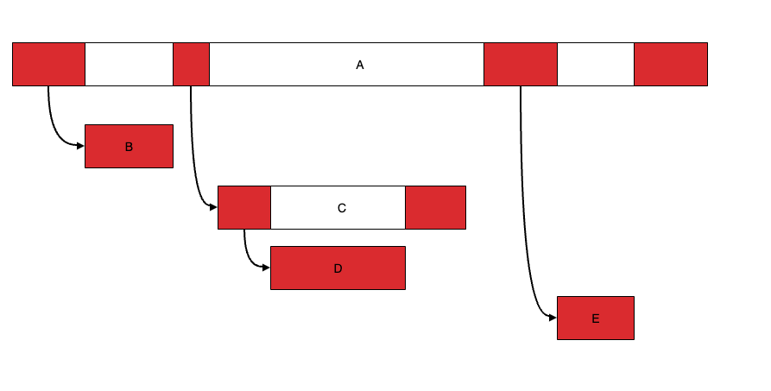
Exemplu de critical path
Notes:
B D E - sunt pe critical path intregi
C - partial pe critical path - dar numai inainte si dupa D

Slide 15
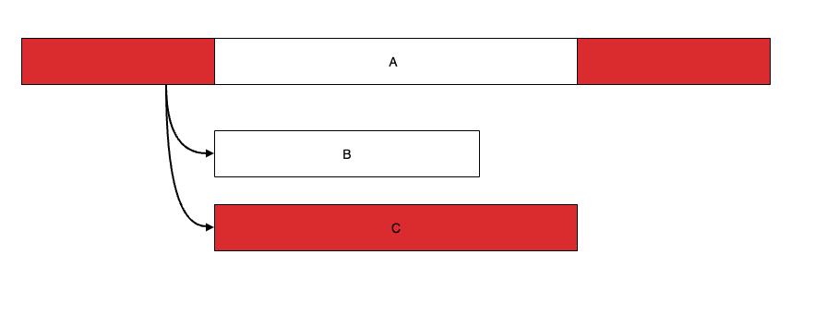
Exemplu de critical path
Notes:
aici degeaga reduci B trebuie redus c
daca reduci C mai mult ca B nu mai e C pe critical path

